Slide 1

6th Grade Math
Unit 7, Lesson 13 Multiplying and Dividing Integers Volume 2, pg. 60

Slide 2


Benchmark
MA.6.NSO.4.2
Apply and extend previous understandings of operations with whole numbers to multiply and divide integers with procedural fluency.
volume 2, pg. 60

Slide 3
Integrated Mathematical Thinking and Reasoning Standards
MA.K12.MTR.3.1 Complete tasks with mathematical fluency.
MA.K12.MTR.4.1 Engage in discussions that reflect on the mathematical thinking of self and others.
volume 2, pg. 60

Slide 4

Learning Target
I can multiply and divide integers with procedural fluency.
volume 2, pg. 60

Slide 5

Warm-Up
volume 2, pg. 61

Slide 6
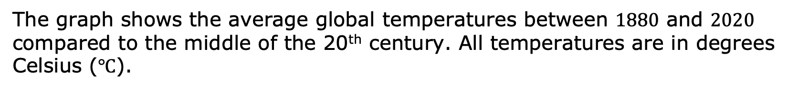
7.13.1 Warm-Up: What’s Going on in This Graph?
The graph shows the average global temperatures between $1880$ and $2020$ compared to the middle of the 20th century. All temperatures are in degrees Celsius (℃).
volume 2, pg. 61

Slide 7
What are you curious about after examining the graph?
Imagine this graph is included in a newspaper article. Write a catchy headline that captures what’s going on in the graph.
volume 2, pg. 61

Slide 8

Refresher
volume 2, pg. 61

Slide 9

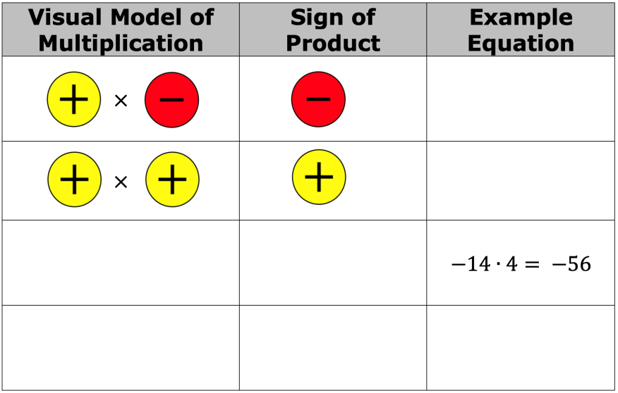
7.13.2 Refresher: Multiplying and Dividing Integers
Work with your partner to complete the tables. The last row of each table is missing both the rule and an example equation.
volume 2, pg. 61

Slide 10
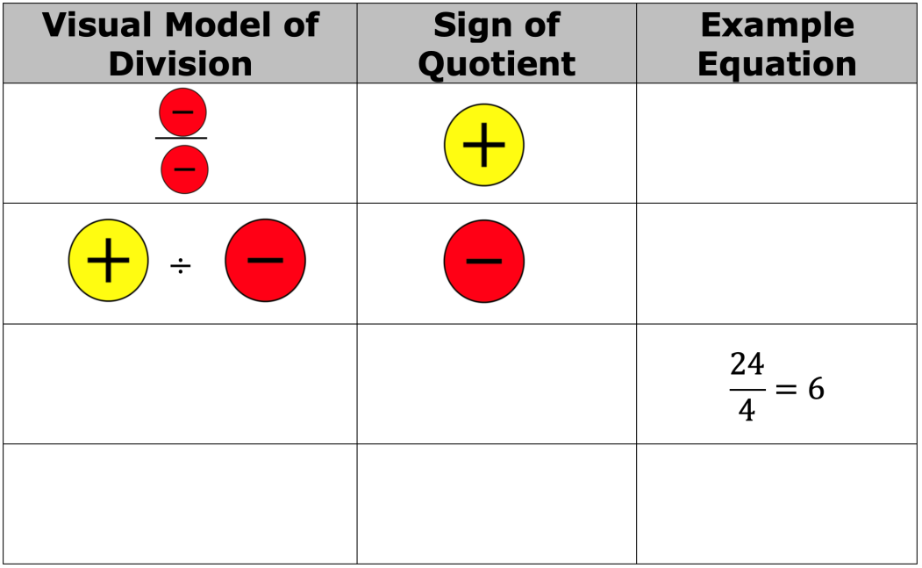
volume 2, pg. 61

Slide 11

Collaboration
volume 2, pg. 62

Slide 12

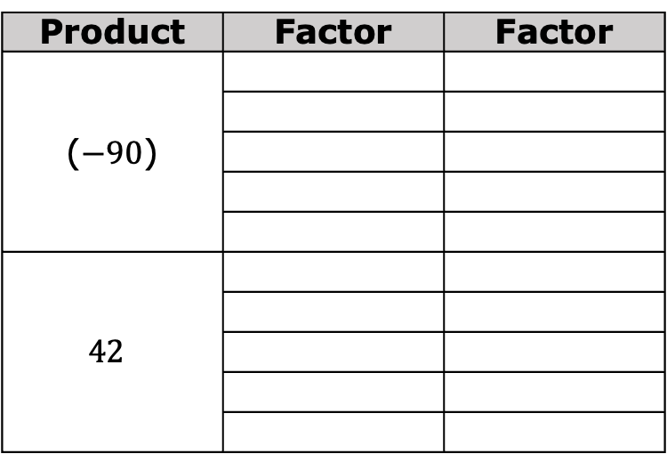
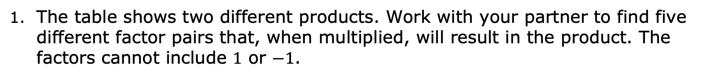
7.13.3 Collaboration: Multiplying and Dividing Integers
The table shows two different products. Work with your partner to find five different factor pairs that, when multiplied, will result in the product. The factors cannot include $1$ or $−1$.
Product | Factor | Factor
($−90$)
$$42$$
volume 2, pg. 62

Slide 13
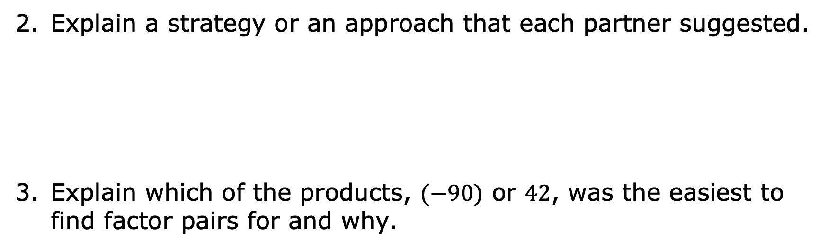
Explain a strategy or an approach that each partner suggested.
Explain which of the products, $(−90)$ or $42$, was the easiest to find factor pairs for and why.
volume 2, pg. 62

Slide 14
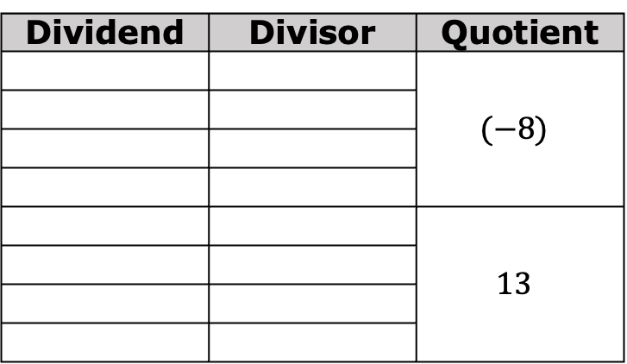
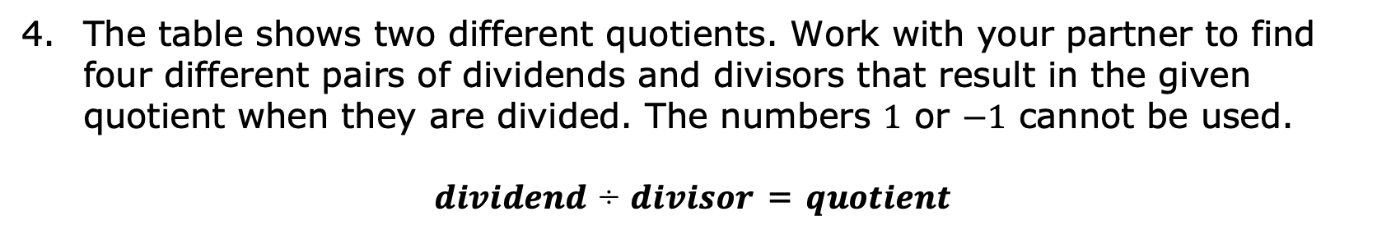
The table shows two different quotients. Work with your partner to find four different pairs of dividends and divisors that result in the given quotient when they are divided. The numbers $1$ or $−1$ cannot be used.
𝒅𝒊𝒗𝒊𝒅𝒆𝒏𝒅 ÷ 𝒅𝒊𝒗𝒊𝒔𝒐𝒓 = 𝒒𝒖𝒐𝒕𝒊𝒆𝒏𝒕
Dividend | Divisor | Quotient
 |  | $$(−8)$$
 |  | $$13$$
volume 2, pg. 62

Slide 15

Explain a strategy or an approach that each partner suggested.
Explain which of the quotients, $(−8)$ or $13$, was the easiest to find dividends and divisors for and why.
volume 2, pg. 62

Slide 16

Guided Practice
volume 2, pg. 63

Slide 17


7.13.4 Guided Practice: Finding Missing Factors, Products, or Quotients
Fill in the missing values to make each equation true.
$(−7)∙ ____ = −14$
$____ ÷(−5) = 7$
$\frac{−40}{8}= ____$
$____ ×(−9) = 63$
volume 2, pg. 63

Slide 18
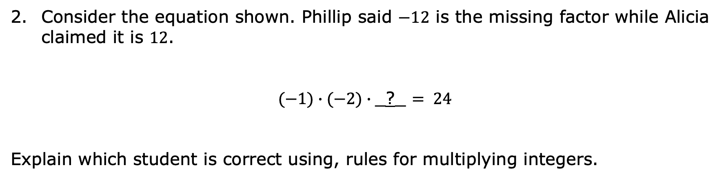
Consider the equation shown. Phillip said $−12$ is the missing factor while Alicia claimed it is $12$.
$(−1)∙(−2)∙$_?_ $= 24$
Explain which student is correct using, rules for multiplying integers.
volume 2, pg. 63

Slide 19

Your Turn
volume 2, pg. 63

Slide 20

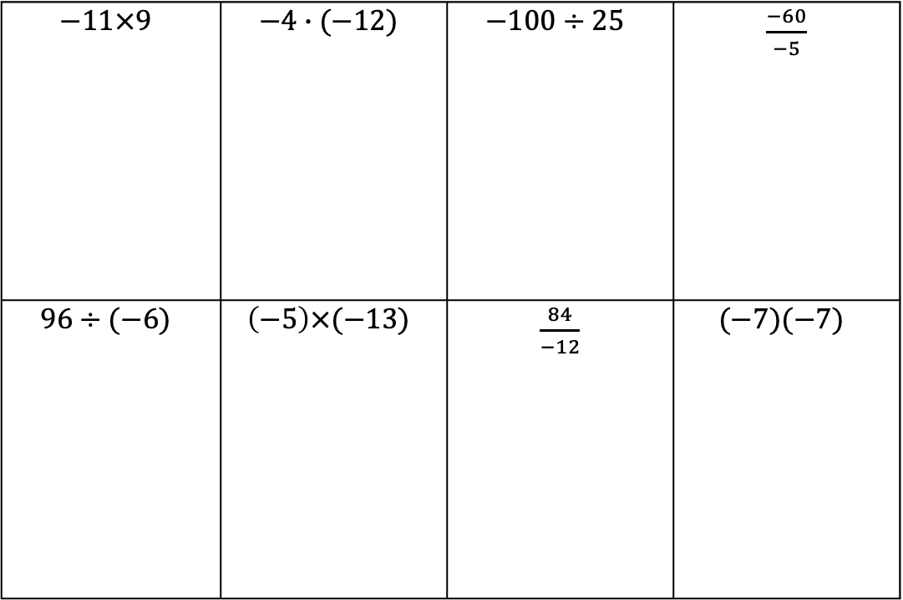
7.13.5 Your Turn!
Find each product or quotient.
$$−11×9$$ | $$−4∙(−12)$$ | $$−100÷25$$ | $\frac{−60}{−5}$
$$96÷(−6)$$ | $$\left(−5\right)×(−13)$$ | $\frac{84}{−12}$ | $$(−7)(−7)$$
volume 2, pg. 63

Slide 21
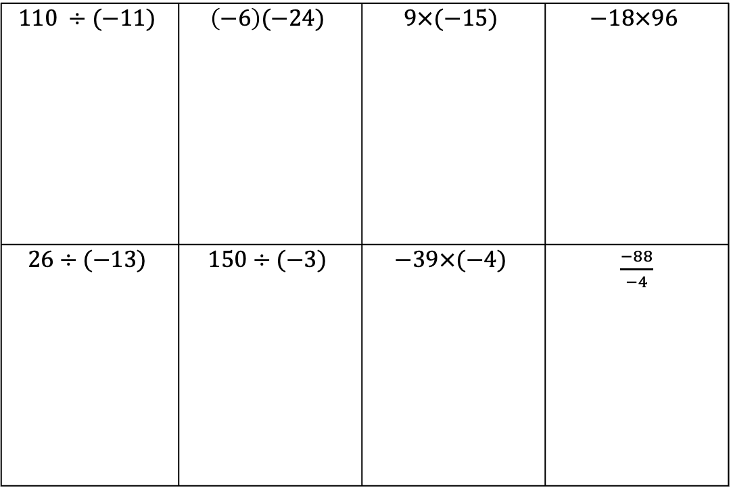
$$110 ÷(−11)$$ | $$\left(−6\right)(−24)$$ | $$9×(−15)$$ | $$−18×96$$
$$26÷(−13)$$ | $$150÷(−3)$$ | $$−39×(−4)$$ | $\frac{−88}{−4}$
volume 2, pg. 63

Slide 22

Wrap-Up
volume 2, pg. 64

Slide 23
7.13.6 Wrap-Up: Reflection
Complete the learning period based on today’s lesson.
One question I would like to have answered …
One mistake I learned from today …
One thing I am not sure about … YET!
One thing I am confident I know is …
volume 2, pg. 64

